Slide 1
SALT LAB
Harsh
Notes:
Its been a long week with mid terms and other assignments. And as a result of which I was not able to join the last call.

Slide 2
Progress and Findings till date
Analysis and cleaning of dispatcher-victim dataset.
Sentiment extraction and graphing done using Bert-perspectives to get features of emotional transition between conversation and gauge total emotion of the sentence.
Transform the dataset and perform statistical analysis on the data to understand trends and patterns in the conversation.
Investigate the different methods to mitigate the issues discussed above.
Notes:
Talking about my progress and finding till now,
- I receivd a dispatcher-victim data from Yiren for analysis.
- On further inspection, the dataset did contain certain ambigious conversations which required to be cleaned. I used certain libraries such as texthero to cleanse the dataset.
- I had used a pretrained model called BERT-Perspectives to extract sentiment of each sentence within the conversation and corrolate it with the sentiment for the entire dataset.

Slide 3
Assumptions
I have only considered a single situation for this usecase – Noise disturbance.
Notes:
Lets look at some of the conditions and assumptions that we have made during t

Slide 4
Important characteristics of the dispatcher bot?
Maximize information gain
Minimize context window which indirectly minimizes conversation length.
Less to none hallucinations during inference.
Notes:
We performed some statistical analysis on the emotion aspect of the dataset.
Common starting emotions include neutral, concerned, upset, annoyed, and distressed.
We can also see that

Slide 5
Some of the various methods to solve the earlier problems?
Usage of Knowledge Graphs
Improving the training data
Fine tuning
RLHF / RLAIF
Notes:
Common ending emotions include neutral, grateful, excited, and frustrated. This indicates that despite starting in various emotional states, there's a tendency towards certain emotional resolutions mentioned above.

Slide 6
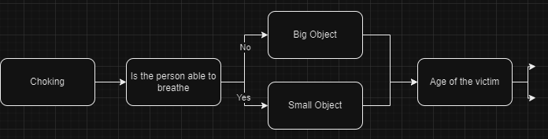
A sample KG

Slide 7
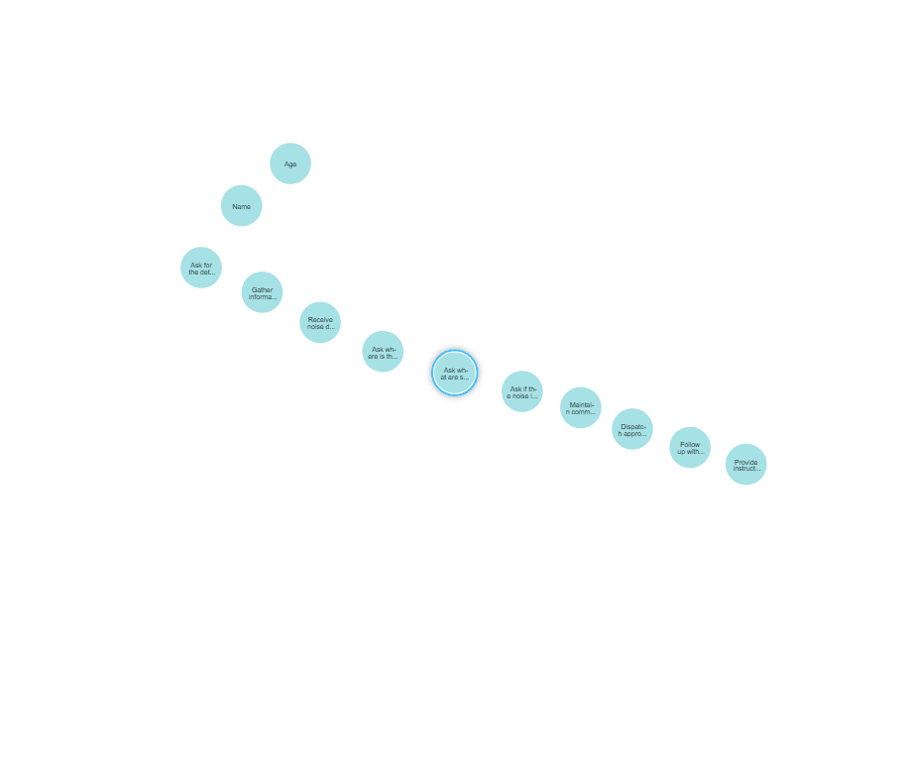
KG used to infer
Notes:
Infer the general patterns in the conversation for a single usecase which here is noise disturbance. The following steps are here.
-> First is to ask for the details of the victim which would be the name and the address.
That would be the collecting details such as name, age and address from the victim.
This is when the user would complain about the issue of noise disturbance to the dispatcher.
Then the next set of action would be to check where this noise is coming from.
Ask where is the possible causes this noise is coming from -> It could be a party, or get together or untimely construction
Ask if the noise is resulting in some sort of health hazard for the user, its hurting their ears, is it creating a structural instability of the building.
Then we come to the final step which is maintain communication from the caller.
Then the bot would call the necessary emergency services.
Followup with the emergency respondance and the user and the last step would be recurring loop until the issue is resolved.

Slide 8
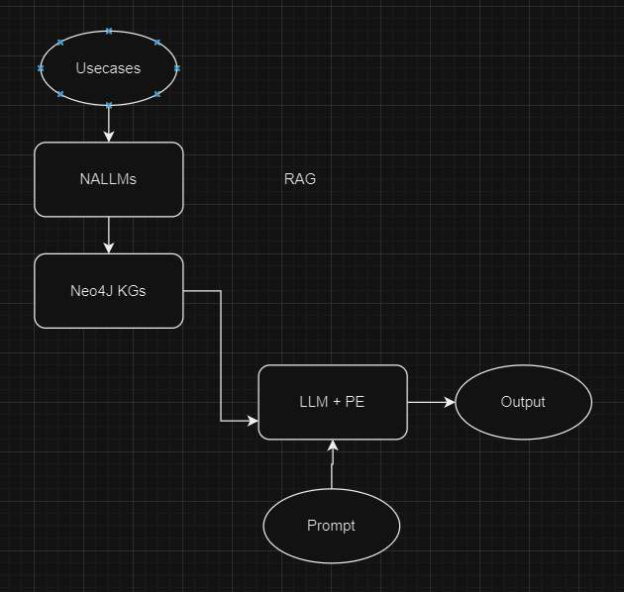
Architecture

Slide 9
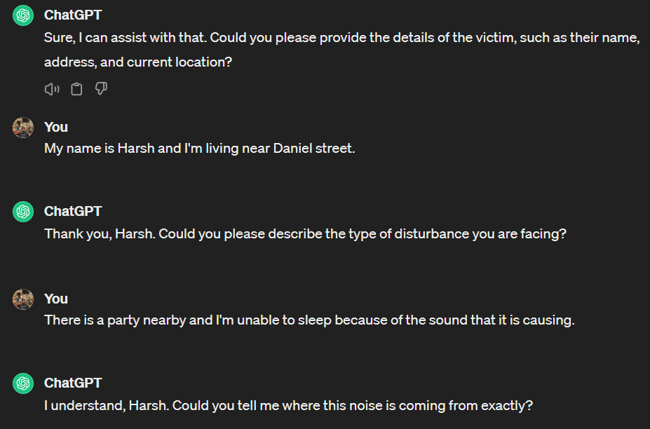
Results

Slide 10
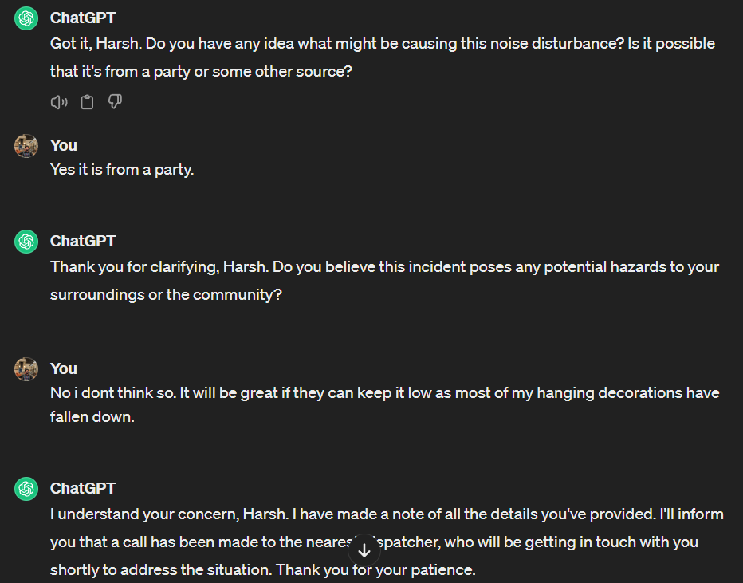
Continuation

Slide 11
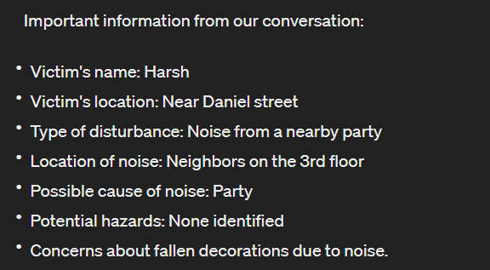
Results
Notes:
How do we reduce time to resolution (TTR) using a LLM?

Slide 12
Metrics
Metrics | LLMs | LLMs + KGs
Avg Length of conversation | 12 Sentences | 6 Sentences
Avg N-O-T | 9 | 5
H - Self check GPT score | 0.87 | 1.0

Slide 13
Conclusion
By examining the cnfiguration and substance of the knowledge graph, LLMs can draw logical conclusions and uncover further insights rapidly, proving beneficial in addressing intricate problems.
LLMs can leverage knowledge graphs to better understand the context of a given issue or problem. By analyzing the relationships between different entities within the knowledge graph, LLMs can infer relevant information and context, enabling them to provide more accurate and comprehensive responses, thereby negating hallucinations.
By analyzing the structure and content of the knowledge graph, LLMs can make logical deductions and infer additional insights at a, which can be valuable for resolving complex issues.
https://arxiv.org/pdf/2306.08302.pdf
https://github.com/neo4j/NaLLM
https://neo4j.com/blog/unifying-llm-knowledge-graph/
Notes:
The possible next steps could be to construct a knowledge of various common senrarious and feed it to the dispatcher bot that both Yiren and Yerong have developed.
Construction of KGs can be done manually or we can train a LLM to construct one or just use a SOTA model such as GPT4 to construct one for us.
We can then use metrics that we saw in the earlier slides to MTTR to check for improvements in the dispatcher model after the implementation of KGs

